Slide 1
Vocabulary
Carbon Cycle
Water Cycle
Nitrogen cycle

Slide 2
Nutrient Cycles
One of the main focuses in this unit is dedicated to investigating and learning about the cycling of certain important elements through the environment.
Oxygen, water, carbon, nitrogen, and phosphorus are a few examples of these that we will focus on in this section.
Your goal will be to learn how a few important elements are recycled through the environment so that they may maintain their availability to living organisms and other important processes as they are requirements for life as it is today.

Slide 3
Nutrient Cycles in Nature
Bio = living
Geo = Earth, ground, soil
Chemical = compound or substance
Cycle = a repeating, cyclical process
Biogeochemical cycles = Repeating processes in which important substances are recycled and reused in the living and non-living parts of the environment by undergoing chemical and/or physical changes.
Water Cycle
Carbon Cycle
Nitrogen Cycle

Slide 4
Water Cycle
The water cycle continuously moves water between the atmosphere, the land, and the oceans.
We see it first hand in several forms.
Rain falls and is soaked up by the ground, or it pools where it’s drank, or it is absorbed by plants, or it will sit and evaporate back up into the atmosphere.
Since it’s a cycle there is no starting point.
We’ll start with water forming in the atmosphere.

Slide 5
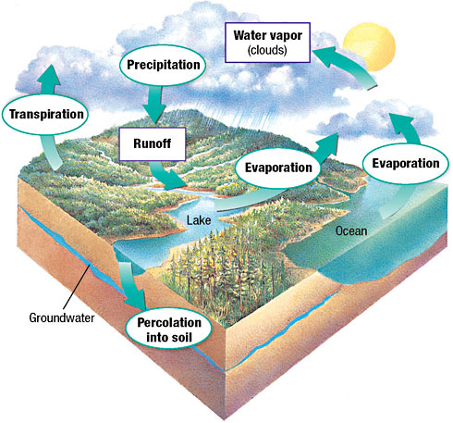
In the margin of your notes, identify the steps numbered 1-6.
Condensation

Slide 6
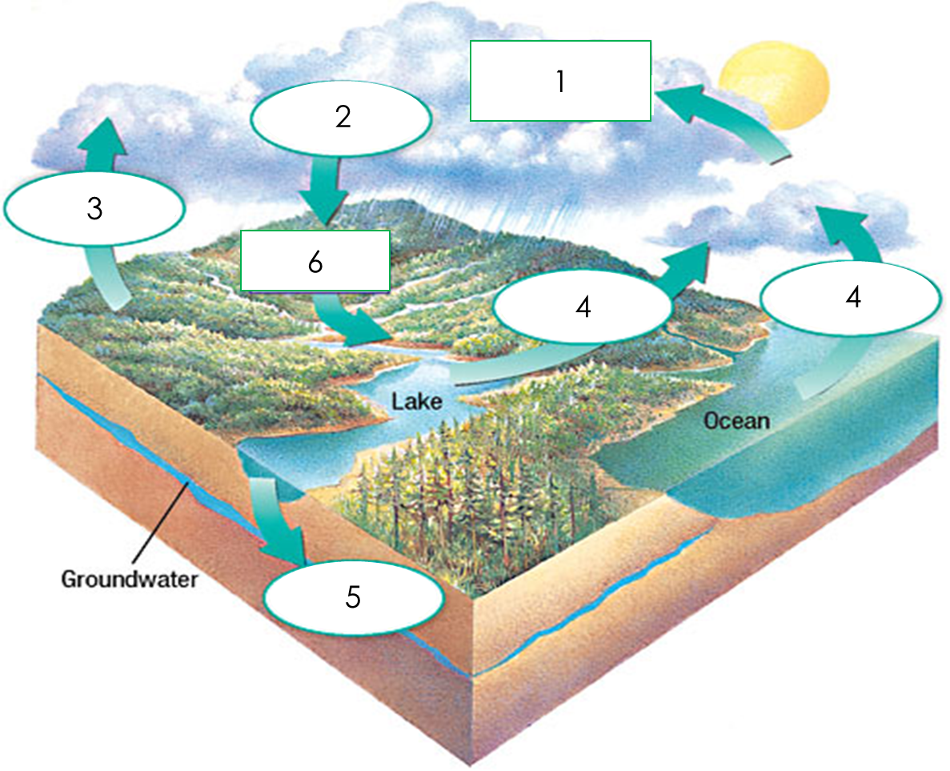
Condensation
First, water vapor condenses in the cool air of the sky into the clouds we see.
Condensation is the process of water molecules combining with each other, forming hydrogen bonds.
Even if there’s no clouds there is still plenty of water there.
At any moment, the atmosphere contains an astounding 37.5 million billion gallons of water, in the invisible vapor phase. This is enough water to cover the entire surface of the Earth (land and ocean) with one inch of rain.
http://whyfiles.org/2010/how-much-water-is-in-the-atmosphere/

Slide 7
Precipitation
When enough water accumulates in the atmosphere it collects a water droplets, gets heavy, and falls back to Earth.
This, what we call rain, is also known as precipitation.

Slide 8
Run off & Percolation
Some of this water percolates, or is absorbed or soaked into the soil and becomes groundwater.
Other water, called runoff, flows and accumulates across the surface of Earth and runs into rivers, lakes, and oceans.

Slide 9
Transpiration & EVAPORATION
Once here if not consumed, the water is heated by the sun and reenters the atmosphere as water vapor by evaporation.
Water also evaporates from trees and plants in a process called transpiration (& animals in perspiration…sweating).

Slide 10
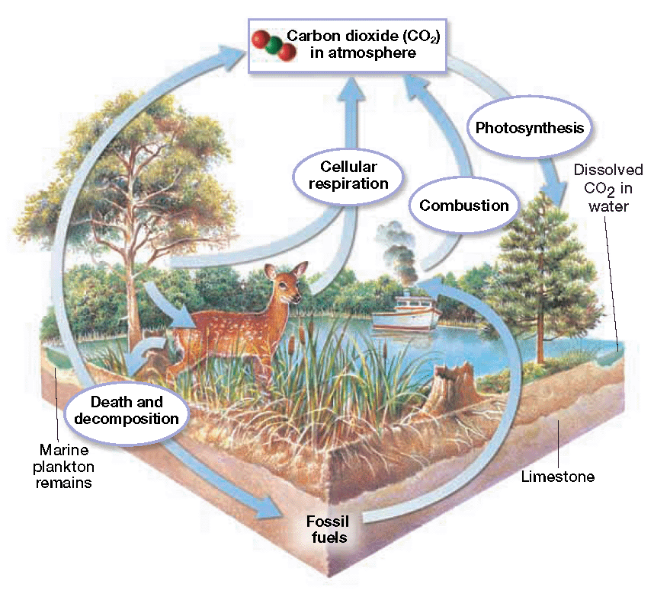
The Carbon Cycle
Starting with atmospheric carbon dioxide, the carbon cycle begins with plants and other autotrophs absorbing CO₂ and water and converting into usable sugars and starches and oxygen using sunlight for energy.
This process is known as photosynthesis.
CO₂ + H₂O + SUNLIGHT ENERGY → SUGARS + O₂

Slide 11
The Carbon Cycle
Animals then eat this vegetation.
They break down the sugars & starches made by plants and covert it into ATP, the energy of life & metabolism.
In the process, they release CO₂ back into the atmosphere.
This process is called cellular respiration.
SUGARS + O₂ → CO₂ + H₂O + ATP ENERGY

Slide 12
The Carbon Cycle
All life, plants, animals & everything else, eventually dies.
When it does it is broken down , decays, and collects as fossil fuels.
Fossil fuels, like oil and gasoline, accumulate after millions of years of this process of death and decay.

Slide 13
The Carbon Cycle
The burning of fossil fuels as well as other combustables, called combustion, also releases carbon dioxide back into the atmosphere.
FOSSIL FUELS + O₂ → CO₂ + H₂O + HEAT ENERGY

Slide 14
The Carbon Cycle: on your handouts, label the parts of the cycle.

Slide 15
The Carbon Cycle

